Slide 1
The mathematics behind large margin classification
Thang Nguyen

Slide 2

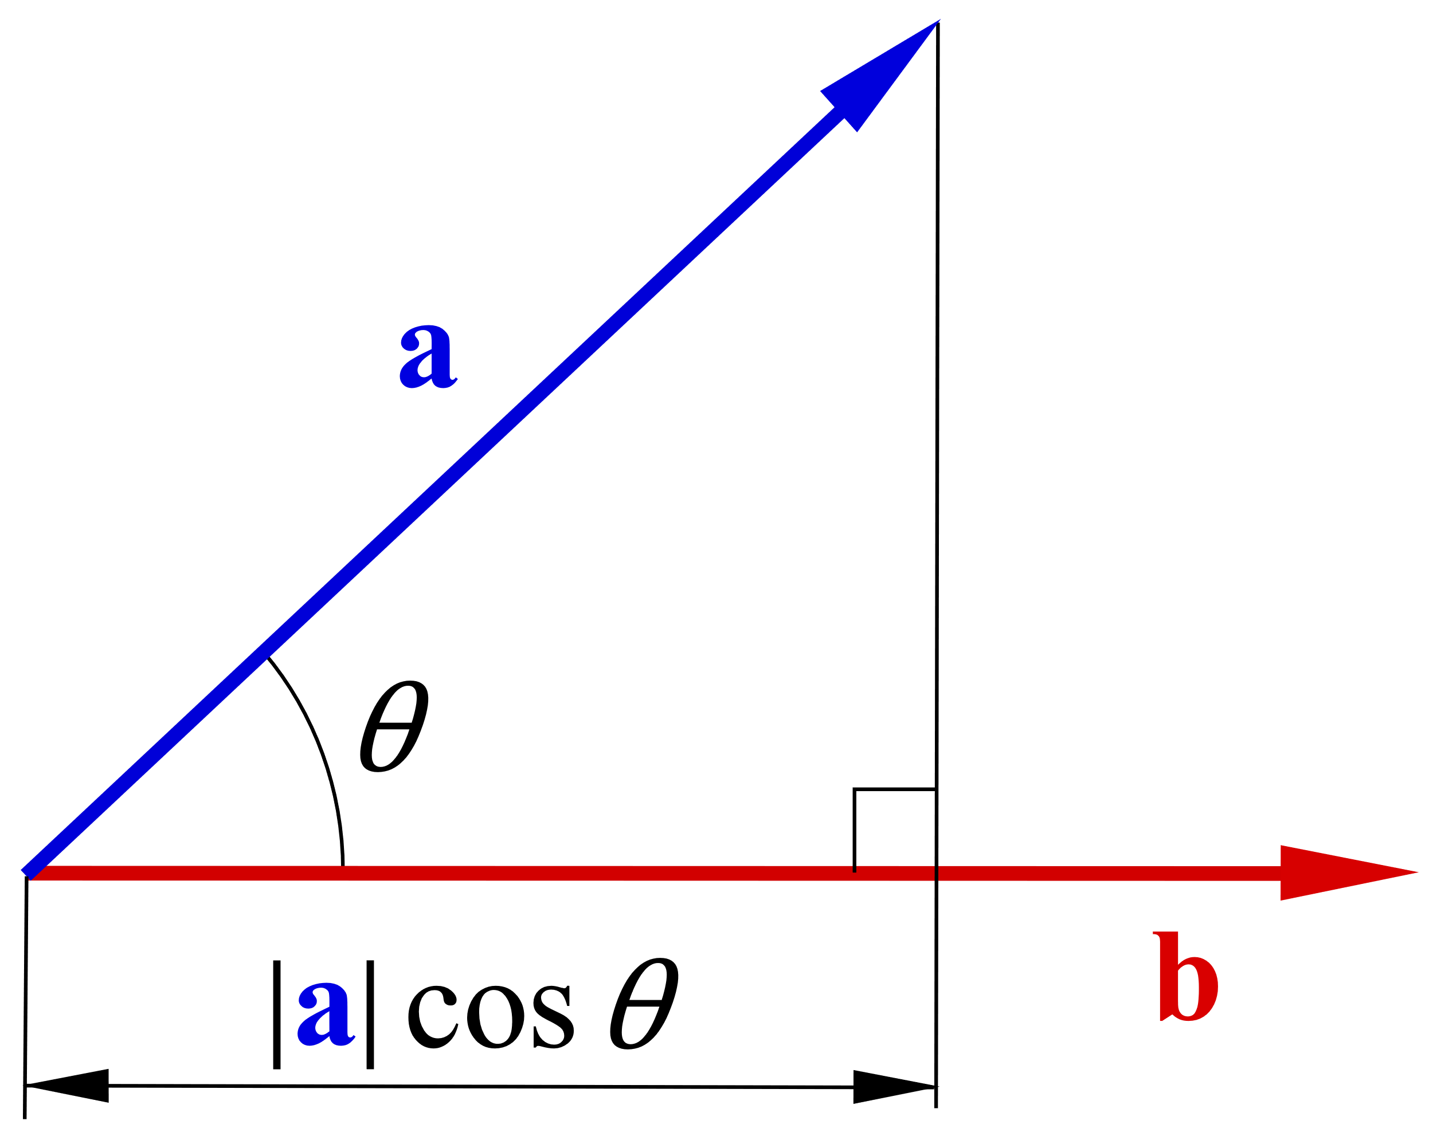
Vector Inner Product

Slide 3

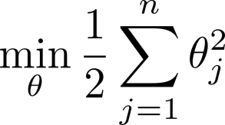

SVM Decision Boundary

Slide 4


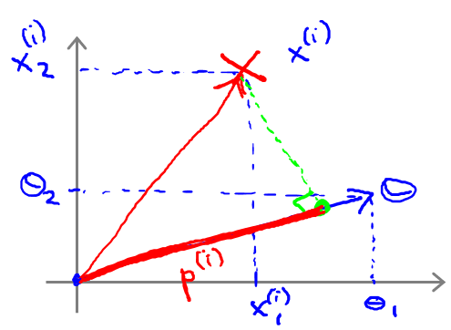
SVM Decision Boundary
Simplification: n = 2

Slide 5

SVM Decision Boundary
Simplification: n = 2

